Slide 1
NATO BILC Terminology CONFERENCE, 09-11 APR 2024, STOCKHOLM
AUSTRIAN ARMED FORCES
National Defence Academy
Comprehensive Security Terminology and Machine Translation
Notes:
1

Slide 2
Comprehensive Security Terminology (CST)
Why is there a need for CST research in Austria?
The last ten years brought up new challenges we were not aware of before they became reality
International cooperation
Austrian German is a minority language in the EU. As a non-NATO member, our security terminology is not compatible with some STANAGS etc.
Comprehensive approach: every ministry has its own terminology
Notes:
2

Slide 3
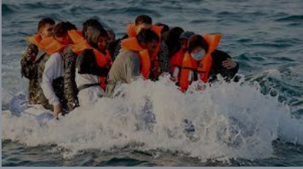
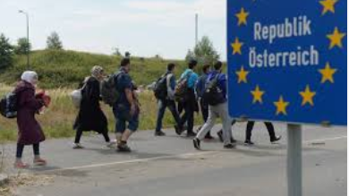
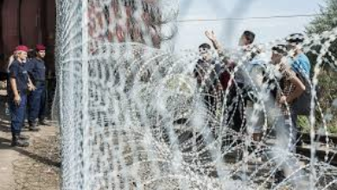
Migration
ÖSTERREICHISCHES
BUNDESHEER
Landesverteidigungsakademie / Sprachinstitut des Bundesheeres
Notes:
Types of crises: migration crisis was the first one in 2015. More than 10.000 refugees per day. For a country like Austria not a daily business. And how creative was the government: Border control, fence wasn´t wanted – barbed wire fence was much worse – so we created terms like double door or door with wings to direct the movement of refugees. To get the whole control over this migration was impossible. Many of them came in without any control, without any dokuments – this is a question of security. Trust is good, control is better (Lenin). First of all it is a job of police or border guard. If police need support, than AAF can help within the framework of legislation for so called assistence operation.

Slide 4
First Case – 2015 – migration crisis
ÖSTERREICHISCHES
BUNDESHEER
Landesverteidigungsakademie /Sprachinstitut des Bundesheeres
1. Armed forces didn´t have a monopoly on security (other departments/ministries are involved)
2. The most important protagonist in our country in this case – police force
3. Common terminology to ensure communication between authorities and to avoid misunderstandings was identified as a need
Notes:
Clarification, especially terminological, is important, if at least two ministries have to cooperate. The terminology of police and armed forces is different. It is an absolute requirement to harmonize the terms, which are used during operation. The most important tool has to secure communication between authorities and to avoid any missunderstanding. A job has to be fulfilled and therefore we have to create a common terminology.

Slide 5
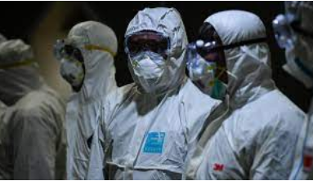
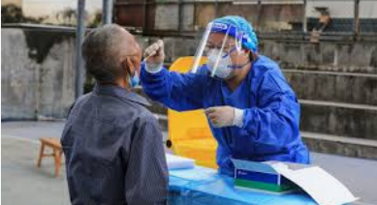
Pandemic
ÖSTERREICHISCHES
BUNDESHEER
Landesverteidigungsakademie / Sprachinstitut des Bundesheeres
Notes:
The following crisis was Covid-19 pandemic. This is still a problem for us, which blongs to the tasks of ministry of health. All Covid-regulations were made by this ministry. The police was responsible for executing the regulations. And here came up at the first time the missing of important terms in our constitutional law. Such concepts like state of emergency does not exist in Austria. The Constitution speaks only about extraordinary circumstances. But if we look for the definition for this circumstances, we cannot find anything. Maybe, this was an extra cause of the decisions of Constitutional court to cancel at about 20 regulations, done by ministry of health. Human Rights Convention principally allows to limit freedom and individual rights on an absolute necessary level.

Slide 6
Second case – 2020 Pandemic
ÖSTERREICHISCHES
BUNDESHEER
Landesverteidigungsakademie /Sprachinstitut des Bundesheeres
1. The most important protagonist in our country in this case – health authorities and police as supporting authority
2. Problem with regulations (Constitutional court cancelled about 20 regulations concerning Covid-19)
Notes:
The special terminology (pandemic) can be completed only by the competent authority. We have in AAF an element for medical service, but, nevertheless, it is not a comprehensive approach (only from the side of military). On the one hand we create a comparative terminology (more than one language – national terminologies are already completed), on the other hand we have to do our homework and create a normative terminology (on the national level). This is the basic for the comparison of different state systems (comparative terminology between two states with different languages, but also with one language [USA – GB, AUT – GER, FIN - SWE]

Slide 7
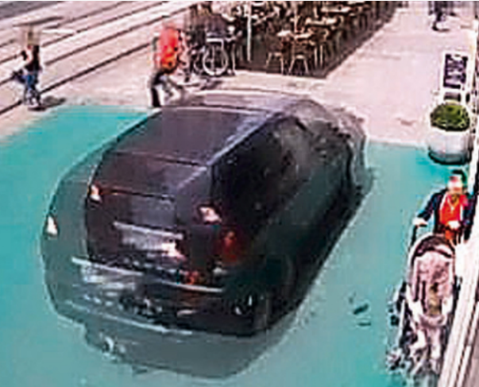
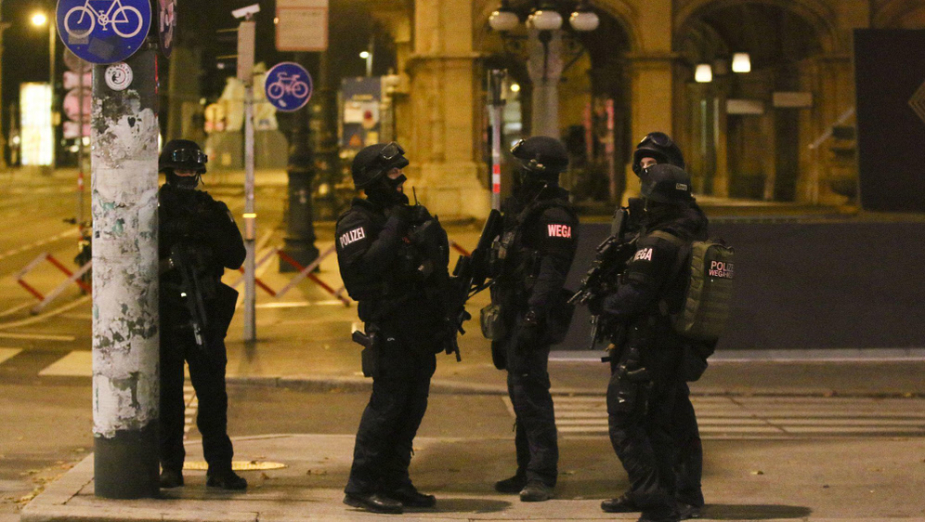
Third case: Terrorism
ÖSTERREICHISCHES
BUNDESHEER
Landesverteidigungsakademie / Sprachinstitut des Bundesheeres
Notes:
The next possible crisis may be an extensive black-out. Here the AAF got the first experiences in exercises after theoretical preparation. Such a black-out concerns many fields in punlic life, beginning with water supply, heating, (candle)light, foods, etc.

Slide 8
Terrorism
ÖSTERREICHISCHES
BUNDESHEER
Landesverteidigungsakademie /Sprachinstitut des Bundesheeres
Graz – 2015
3 died, 36 wounded
Vienna – 2020
4 died, 23 wounded

Slide 9
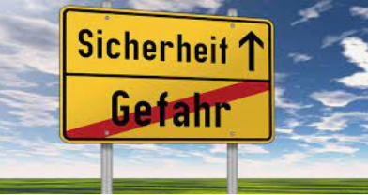
Security is all-embracing and interministerial
ÖSTERREICHISCHES
BUNDESHEER
Landesverteidigungsakademie / Sprachinstitut des Bundesheeres
Sicherheit = security
Gefahr = danger
Notes:
We can make a difference within security in public safety and security and private safety. As an authority of federal republic we work of course in the field of public security and order.

Slide 10
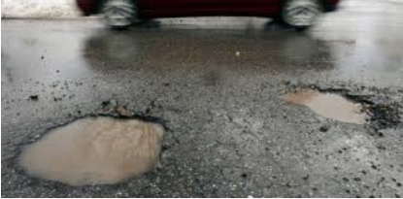
Public security and order
ÖSTERREICHISCHES
BUNDESHEER
Landesverteidigungsakademie / Sprachinstitut des Bundesheeres
There is a lack of concepts
State of emergency does not exist in Austria
State of emergency after natural disaster does not exist in Austria
Notes:
Public security and order – again no legal definition in Austria. In this case we can find alternatives in Germany which concern the public security. She is according to Human Rights Conventionand in Austria naturally useable.

Slide 11
Obstacles to a functional CST
Comprehensive approach: every ministry has a specific terminology of its own with an individual history
There are always two domains for terminology:
Subject matter terminology and Common administrative terminology
Notes:
11

Slide 12
Terminology work emerges
First of all: Normative terminological work –
This means – terminologists have to develop – in cooperation with the specialists in a specific field – the terminology on a national level.
What is the name of this thing?
What does it mean?
Notes:
12

Slide 13
Terminological work on a national level in the field of security
Security is not only a game between „interior“ and „defence“
The mentioned crises touch all ministries
Beginning of comparative terminological work
Notes:
13

Slide 14
Crisis security law
ÖSTERREICHISCHES
BUNDESHEER
Landesverteidigungsakademie /Sprachinstitut des Bundesheeres
„Krisensicherheitsgesetz“ – title „Crisis security management law“ would be the better name.
This law passed Austrian Parliament and is valid from Jan 1st, 2024.
A possible chance to develop security terminology on a legal base.
First nationwide regulation in the field of disaster management regulations of procedures
Necessity of cooperation between all ministries, depending on type of crisis
Notes:
A solid legal base stregthens absolutely the normative terminology on national level. The best solution would be a section with definitions, so it´s clear, what the legislative side of the state will express. And the best development in this field would be a legal liability for cooperation of ministries. In austria every ministry is the highest level of an authority, independent of each other. One minister, even the chancelor, cannot give other ministers directives. Therefore is in the present time such a cooperation voluntary.

Slide 15
Cooperation between ministries
ÖSTERREICHISCHES
BUNDESHEER
Landesverteidigungsakademie /Sprachinstitut des Bundesheeres
Every ministry = independent authority
Necessity of regulations of procedures, in which more than one ministry is involved
Cooperation between ministries needs a terminological base
Legal base would be done with a crisis management law
Notes:
A solid legal base stregthens absolutely the normative terminology on national level. The best solution would be a section with definitions, so it´s clear, what the legislative side of the state will express. And the best development in this field would be a legal liability for cooperation of ministries. In austria every ministry is the highest level of an authority, independent of each other. One minister, even the chancelor, cannot give other ministers directives. Therefore is in the present time such a cooperation voluntary.

Slide 16
Goal of terminology
ÖSTERREICHISCHES
BUNDESHEER
Landesverteidigungsakademie /Sprachinstitut des Bundesheeres
Common normative terminological work in the ministries
Product should be a normative (prescriptive) terminology made by each ministry
Common database
Public access to this database
Notes:
A solid legal base stregthens absolutely the normative terminology on national level. The best solution would be a section with definitions, so it´s clear, what the legislative side of the state will express. And the best development in this field would be a legal liability for cooperation of ministries. In austria every ministry is the highest level of an authority, independent of each other. One minister, even the chancelor, cannot give other ministers directives. Therefore is in the present time such a cooperation voluntary.

Slide 17
Milestones towards a functional CST
First step is to identify and process the specific terminology of a specific matter to provide it with high-quality products with consistent terminology (prescriptive terminology work)
Next step: Processing the terminology in one ministry (in our case: MoD)
Then start an inter-ministerial process to harmonize the different thesauruses of different ministries
Notes:
17

Slide 18
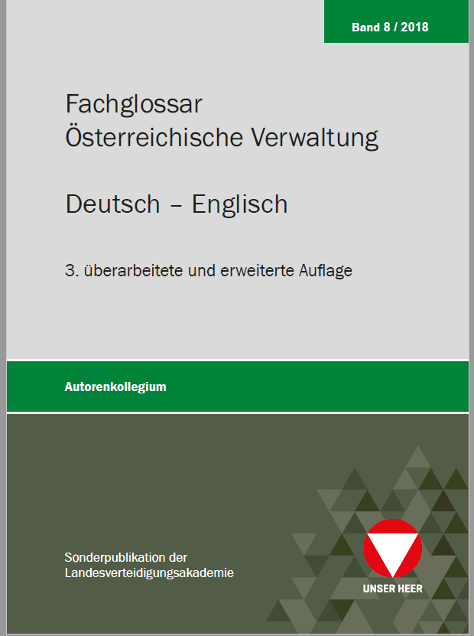
A first product: Technical glossary for Austrian Administration
This glossary was produced by an inter-ministerial process working group to provide reliable terminology for translations into the English language with common administrative terminology (700 terms).
This makes it very useful for different ministries.
It is available without charge: www.sprachressourcen.at
Notes:
18

Slide 19
Machine Translation (MT) – Innovative Technologies for the Public Sector
Notes:
19

Slide 20
The Public Sector in Western democracies faces several crucial challenges (I)
Digitalisation of core processes
Need for efficient Knowledge Management (KM) to prevent loss of knowledge due to retirements in the next few years
Need to be aware of innovative technologies in this field
Implementation of best-practice solutions in its own organizations to enhance effectivity and efficency of KM
Overwhelming amount of information and documents (in an abundant number of languages) leads to a large need for multilingual communication skills
Machine Translation Systems (MTS) can contribute a solution to this problem.
Notes:
20

Slide 21
The Public Sector in Western democracies faces several crucial challenges (II)
Current situation:
Licence products such as DeepL Pro, IBM Watson or RWS Language Weaver OR
Innovative free-of-charge tools like Google Translate, DeepL, ChatGPT or Google Gemini – PROBLEM: Where goes my data to? How to handle confidential issues?
Security, sovereignty or ownership of data are at risk.
Quality of translation cannot be certified – no proof-reading by academic linguists!
Notes:
21

Slide 22
How does MT come into play?
As mentioned above, a consistent terminology of common as well as subject matter terminology (in our case: CST) is crucial.
Austrian terminology in both fields is very specific
8 mio speakers in Austria compared to 80 mio in Germany!
Tools like e-translation (European Commission) could help to integrate Austrian CST
Notes:
22

Slide 23
Benefits of MT systems (I)
Data security and data sovereignty: highest standards can be provided. On-premises servers can minimize risk of data being stolen or lost.
Authentification and authorization: Access to the system is strictly controlled and is only given to personnel with a security clearance. Classified matters are protected against export.
Saving money: Translation services by third parties can be very expensive. Existing texts can be implemented into the engine. Via interface tools like RWS Studio, they can be integrated into the MT system.
Notes:
23

Slide 24
Benefits of MT systems II
Efficiency: “traditional“ translation can slow down working procedures or interfere with a need for quick decisions. Large documents can be scanned for gisting; a quick overview of the main topics of a document. The system is available 24/7 via VPN.
Synergy effects: Existing high-quality data can be easily imported, existing portals be implemented for multi-purpose use in order to save resources.
Notes:
24

Slide 25
Interministerial Task Group
In March 2024, a first meeting of the CDOs of most Austrian ministries took place to plan the roadmap towards implementing an Austrian governmental MT tool. First milestones will be:
Evaluation of existing solutions
Development of best practises
Building up capacities
Establishing a cooperation with experts (researchers, entrepreneurs etc.)
Notes:
25

Slide 26
Conclusion
This concentration of efforts, resources and expertise can make Public Administration/Management more efficient.
Improvement of communication and exchange of knowledge – no matter which languages are involved!

Slide 27
Si vis pacem – para bellum!
Please contact me via e-mail:
walter.rys@bmlv.gv.at

